Slide 1

PROJECT PRESENTATION
2022

Slide 2
TEAM MENTOR
Ms : SHALIKA ARORA
TEAM MEMBERS
NITIKA PATEL
SHUBHAM JAIN
PIYUSH KUMAR

Slide 3
BIT LEARNER
Introduction
Bit learner is a website which will provide study material like java , C , C++ , HTML , CSS etc.. The contents written in the website are very easy to understand and due to it It will be proved beneficial for all the user visited to the website Contents written in the website are presented using graph and images Our mind also learn easily from images and graph Bit Learner is a platform to enhance knowledge and to arrive the dentiny In very less time because all things are on the contents if these are in written in easy language then user can understand easily but if the contents are in the tough language user will never visit on it… Overview:- Bit Learner collection of many subjects on a single platform In a well way Contents are precisely and to the point. Contents are Written in simple formet and we'll manners Each topic is well organised and written in very short for

Slide 4
Description
Project Description
Bit Learner is a platform where users can fulfill requirements regarding their study completely.. The goal of the website is to provide complete subject in a precisely and to the point.. Study material is in very basic language so that user can understand it very well understand it so well... The theme of the website is to help the people to encourage their skills and the subjects deeply with the help of graph and images . On this website contents are on well structured way And important points are highlighted so that user will understand the subjects in a very less time.. Contents are in simple forme

Slide 5
Scope of the project
Scope of the project
(i) Accessible from anywhere
(ii) Open in all browsers and very easy to handle it..
(iii) Available to all and provide services to all..
(iv) Fast accessibility of contents with proper structure and well organised way
(v) Contents are represented with proper diagram and suitable example.Images are used because mind read it very shortly.

Slide 6
HARDWARE and SOFTWARE REQUIREMENTS
HARDWARE REQUIREMENTS
Processor :Dual Core 2nd generation RAM : 2GB or more
HARD DISK : 80GB
OPERATING SYSTEM: Windows 7 and Above Software Requirements FRONT END: Html,CSS,JavaScrip

Slide 7
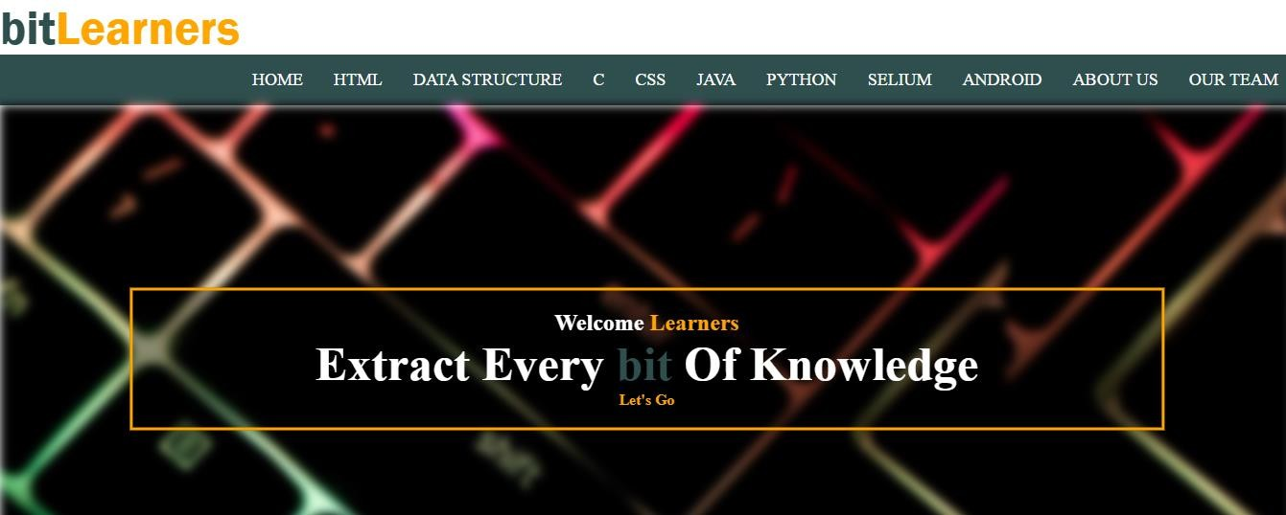
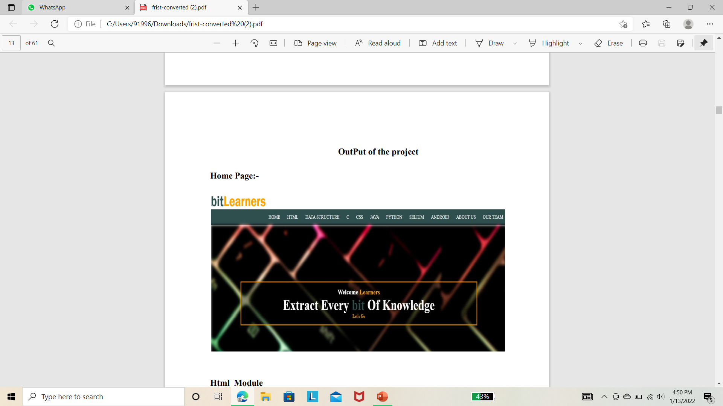

Slide 8
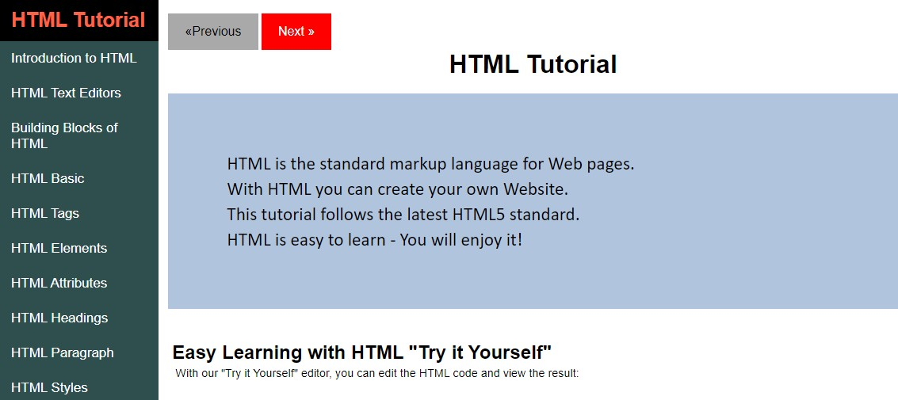
HTML Tutorial

Slide 9
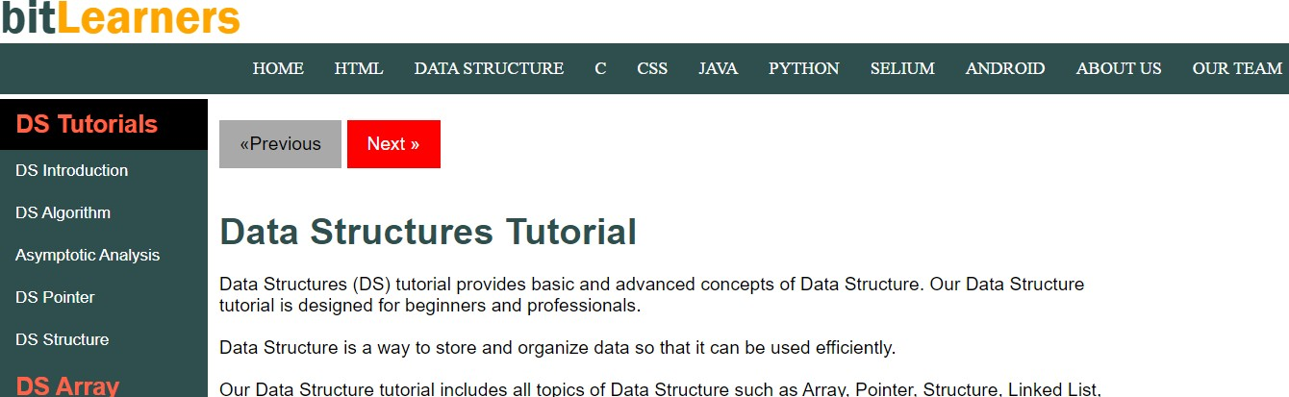
DS Tutorial

Slide 10
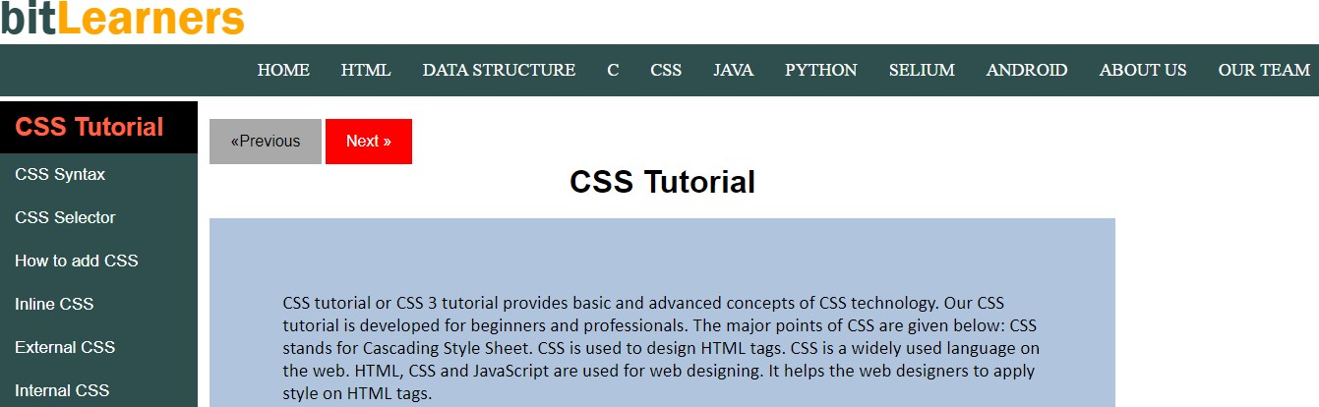
CSS Tutorial

Slide 11


